Slide 1
COMPUTER & COMMUNICATION TECHNOLOGY. BICT 1103
Lecture 5: Information Systems.

Slide 2
What are information systems?
An information system is a group of interrelated components that work to carry out input, processing, storage, output and control actions in order to convert data into information that can be used to support forecasting, planning, control, coordination, decision making and operational activities in an organisation.

Slide 3
Decision-Making Levels of an Organization
Executive level (top)
Long-term decisions
Unstructured decisions
Managerial level (middle)
Decisions covering weeks and months
Semi-structured decisions
Operational level (bottom)
Day-to-day decisions
Structured decisions

Slide 4
TYPES OF INFORMATION SYSTEM
1. Transaction Processing System (TPS)
2. Management Information System (MIS)
3. Decision Support System (DSS)
4. Executive Information System (EIS)
5. Expert System (ES)
6. Office Automation System

Slide 7
TRANSACTION PROCESSING SYSTEM
Transaction Processing System are operational-level systems at the bottom of the pyramid.
They are also called Data Processing System (DPS)
They are usually operated directly by shop floor workers or front line staff, which provide the key data required to support the management of operations.
This data is usually obtained through the automated or semiautomated tracking of low-level activities and basic transactions.

Slide 8
Transaction = an event that generates or modifies data
Used at Operational level of the organization
Processes business events and transactions to produce reports
Goal:
to automate repetitive information processing activities
within organizations
Increases speed
Increases accuracy
Greater efficiency
Supports the monitoring, collection, storage, processing, and dissemination of the organization’s basic business transactions
Mainly includes accounting and financial transactions
Mainly used for providing other information systems with data.

Slide 10
Role of TPS
Produce information for other systems
Cross boundaries (internal and external)
Used by operational personnel + supervisory levels
Efficiency oriented
Examples
Payroll processing
Sales and order processing
Inventory management
Accounts payable and receivable

Slide 11
OBJECTIVES OF TPS
Efficient and effective operation of the organization
Provide timely documents and reports
Increases the competitive advantage
Provides necessary data for tactical and strategic systems such as DSS
Provide a framework for analyzing an organization’s activities

Slide 13
MANAGEMENT INFORMATION SYSTEM
A MIS is a system that converts data from internal and external sources into information, communicated in an appropriate form to managers at different levels of an organisation.
The information can contribute to effective decision making or planning to be carried out.
MIS are built on the data provided by the TPS

Slide 14
MIS produce reports for managers interested in historic trends on a weekly, monthly and yearly basis (not on the day-to-day activities of the DPS).
The information in these reports provides answers to routine pre-defined questions.
An example from a supermarket will provide reports that show the sales figures for each department each day for a week, with weekly totals, monthly totals, comparisons with last month and the corresponding month last year.
Once the information is in the system many reports can be extracted.

Slide 15
Some examples of MIS
Sales management systems
Inventory control systems
Budgeting systems
Management Reporting Systems (MRS)
Personnel (HRM) systems

Slide 16
OBJECTIVES OF MIS
Provide summary information of organizational activity at periodical intervals
Operational control and efficiency
Focus on internal information
Useful to structured decisions

Slide 17
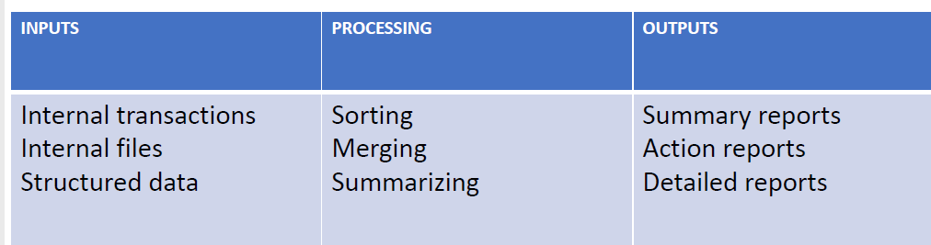
FUNCTIONS OF MIS

Slide 19
DECISION SUPPORT SYSTEM
A Decision Support System can be seen as a knowledge based system, used by senior managers, which facilitates the creation of knowledge and allow its integration into the organization.
These systems are often used to analyze existing structured information and allow managers to project the potential effects of their decisions into the future.
Such systems are usually interactive and are used to solve ill structured problems.
They offer access to databases, analytical tools, allow "what if" simulations, and may support the exchange of information within the organization.
An effective blend of human intelligence, information technology and software.
DSS manipulate and build upon the information from a MIS and/or TPS to generate insights and new information

Slide 20
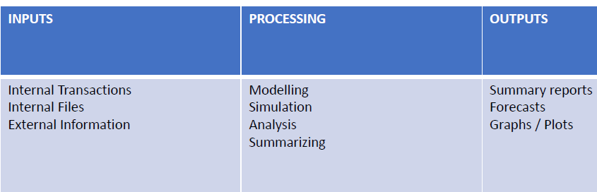

Slide 22
Role of DSS
• Support ill- structured or semi-structured decisions
• Have analytical and/or modelling capacity
• Used by more senior managerial levels
• Are concerned with predicting the future
• Are effectiveness oriented

Slide 23
Some examples of DSS
• Group Decision Support Systems (GDSS)
• Computer Supported Co-operative work (CSCW)
• Logistics systems
• Financial Planning systems
• Spreadsheet Models

Slide 24
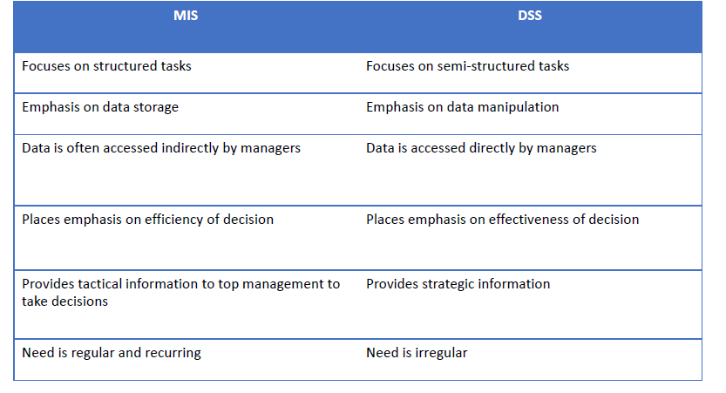

Slide 25
EXECUTIVE INFORMATION SYSTEM
Specialized form of DSS
Used by top-level managers
• Also known as Executive Support System
An EIS provides senior managers with a system to assist in taking strategic and tactical decisions.
Its purpose is to analyse, compare and identify trends to help the strategic direction of the organisation.
EIS address unstructured decisions and create a generalised computing and communications environment, rather than providing any fixed application or specific capability.
Such systems are not designed to solve specific problems, but to tackle a changing array of problems.
EIS are designed to incorporate data about external events, such as new tax laws or competitors, and also draw summarised information from internal MIS and DSS.

Slide 26
EXECUTIVE INFORMATION SYSTEM
These systems filter, compress, and track critical data; emphasising the reduction of time and effort required to obtain information useful to strategic management.
They employ advanced graphics software to provide highly visual and easy-to-use representations of complex information and current trends, but they tend not to provide analytical models.
EIS allow the user to look at specific data that has been summarised from lower levels within the organisation and then drill down to increase the level of detail, which is provided by the information systems in different areas.

Slide 27
EXPERT SYSTEMS
An expert system is a computer program that tries to emulate human reasoning. It does this by combining the knowledge of human experts and then, following a set of rules, it draws inferences.
An expert system is made up of three parts: a knowledge base; an inference engine; a user interface.
The knowledge base stores all of the facts, rules and information needed to represent the knowledge of the expert.
The inference engine is the part of the expert system that interprets the rules and facts using backward and forward chaining to find solutions to user queries.
The user interface allows the user to enter new knowledge and query the system.

Slide 28
Reasons for expert systems in business:
To store information in an active form as organisational memory, creating an organisational knowledge base that many employees can examine and preserving expertise that might be lost when an acknowledged expert leaves the organisation
To create a mechanism that is not subject to human feelings, such as fatigue and worry. This may be especially useful when jobs may be environmentally, physically or mentally dangerous to humans. These systems may also be useful advisers in times of crisis.
To enhance the organisation’s knowledge base by generating solutions to specific problems that are too substantial and complex to be analysed by human beings in a short period of time

Slide 29
Expert systems can be used in several areas of an organisation:
Accounting and finance
• In selecting forecasting models
• In providing tax advice
Marketing
• In establishing sales quotas
• In responding to customer inquiries
Manufacturing
• In determining whether process is running correctly
• In analysing quality and providing corrective actions
• In product design and layout
Others
• In assessing project proposals, etc

Slide 30
OFFICE AUTOMATION SYSTEMS
Office automation is the integration of computer, telecommunications and office equipment technologies to improve the execution of business functions through increasing the productivity, effectiveness and working conditions of office support.
The concept of office automation encompasses the application of computer and communication technology to improve the productivity of all types of office workers including clerical, administrative, professional and executive.

Slide 31
Help people perform personal record keeping, writing, and calculations efficiently.
Aim is to improve the productivity of managers at various levels of management by providing secretarial assistance and better communication facilities.
Main types of tools include:
• Spreadsheet programs
• Text & image processing systems
• Presentation packages
• Personal database systems and note-taking systems
Examples:
• Communicating and scheduling
• Document preparation
• Analyzing data
• Consolidating information

Slide 32
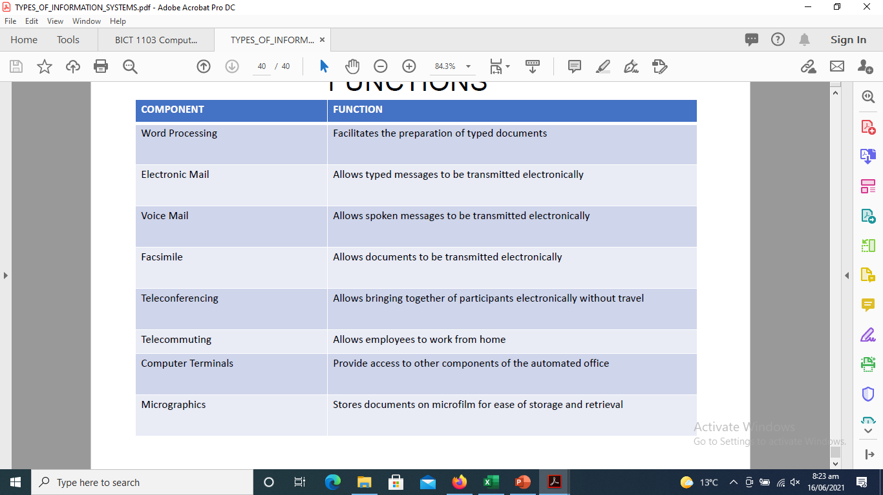
COMPONENTS OF OFFICE AUTOMATION SYSTEM AND THEIR FUNCTIONS

Slide 33
System Development Life Cycle
A system development life cycle or SDLC is essentially a project management model.
It defines different stages that are necessary to bring a project from its initial idea or conception all the way to deployment and later maintenance.
Advantages and disadvantages of SDLC
Benefits of abiding by a clearly defined SDLC model include:
Having a clear view of an entire project, workers involved, estimated costs and timelines.
Gives project managers a projected base cost of the project.
Goals and standards are clearly defined.
Developers can move back a step if something does not go as expected.

Slide 34
Disadvantages:
Due to assumptions made at the beginning of a project, if an unexpected circumstance complicates the development of a system, then it may stockpile into more complications down the road. As an example, if newly installed hardware does not work correctly, then it may increase the time a system is in development, increasing the cost.
Some methods are not flexible.
It can be complicated to estimate the overall cost at the beginning of a project.
Testing at the end of development may slow down some development teams.

Slide 35
SDLC models
Various SDLC methodologies have been developed to guide the processes involved, including the
the Waterfall model
rapid application development (RAD)
joint application development (JAD)
the fountain model,
the spiral model,
Agile software development.

Slide 36
Waterfall model
Waterfall approach was first SDLC Model to be used widely in Software Engineering to ensure success of the project.
In "The Waterfall" approach, the whole process of software development is divided into separate phases.
In this Waterfall model, typically, the outcome of one phase acts as the input for the next phase sequentially.

Slide 37
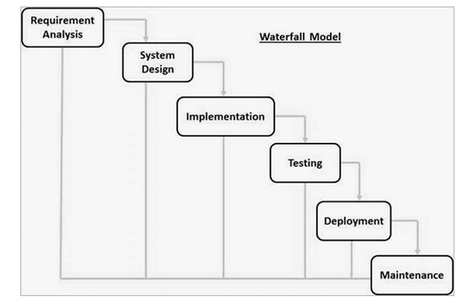

Slide 38
Requirement Gathering and analysis − All possible requirements of the system to be developed are captured in this phase and documented in a requirement specification document.
System Design − The requirement specifications from first phase are studied in this phase and the system design is prepared. This system design helps in specifying hardware and system requirements and helps in defining the overall system architecture.
Implementation − With inputs from the system design, the system is first developed in small programs called units, which are integrated in the next phase. Each unit is developed and tested for its functionality, which is referred to as Unit Testing.

Slide 39
Integration and Testing − All the units developed in the implementation phase are integrated into a system after testing of each unit. Post integration the entire system is tested for any faults and failures.
Deployment of system − Once the functional and non-functional testing is done; the product is deployed in the customer environment or released into the market.
Maintenance − There are some issues which come up in the client environment. To fix those issues, patches are released. Also to enhance the product some better versions are released. Maintenance is done to deliver these changes in the customer environment.

